Slide 1
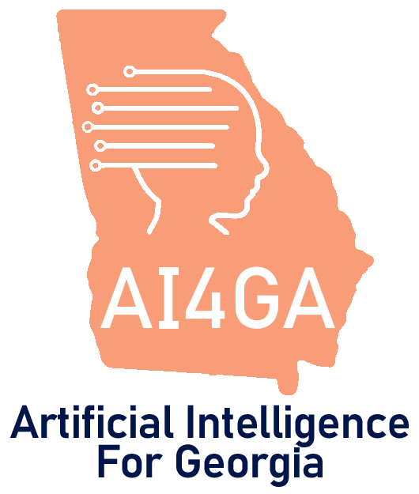
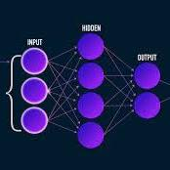

Module 3.5
Neural Networks
Living and Working with Artificial Intelligence
Developed for the AI4GA (Artificial Intelligence for Georgia) project funded by National Science Foundation awards DRL-2049029 and DRL-2048502.
Additional funding was provided by a gift from Google. This work is licensed under the Creative Commons Attribution-NonCommercial-ShareAlike 4.0 International License. https://creativecommons.org/licenses/by-nc-sa/4.0/

Slide 2
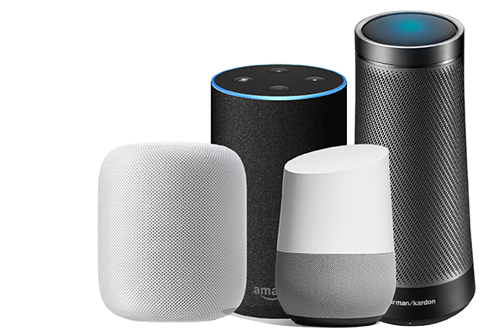
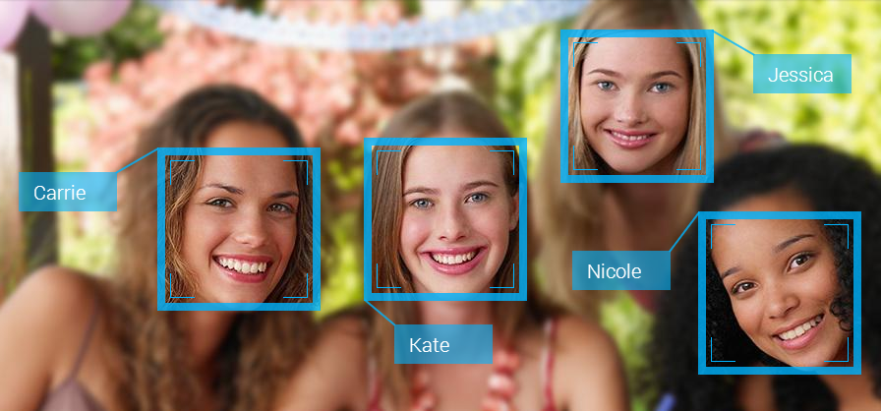
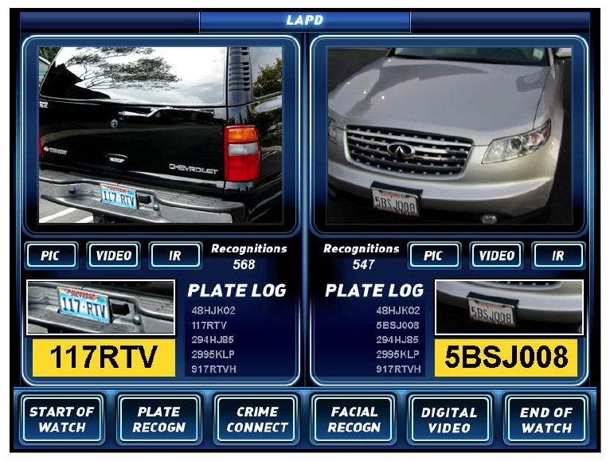

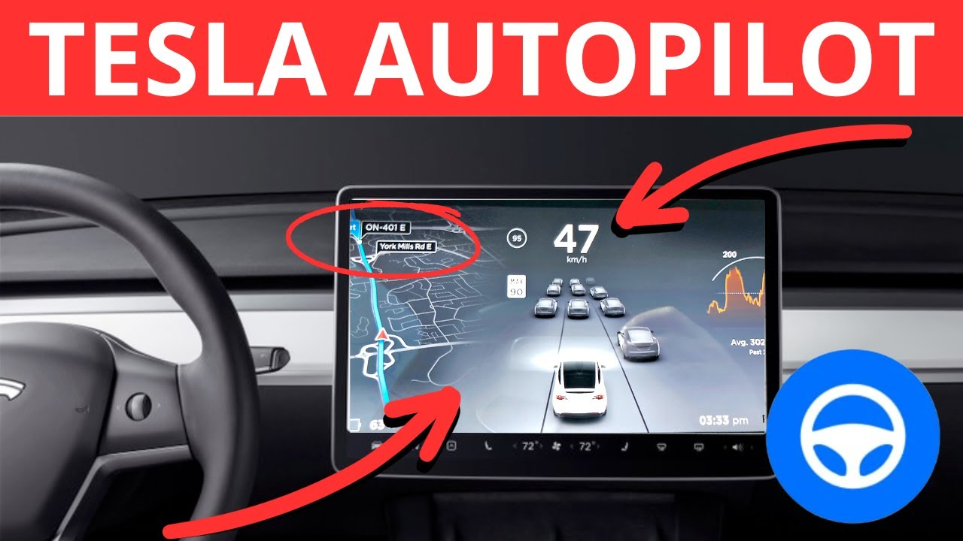
A lot of the AI applications you’ve used have neural networks inside of them.
This is the dominant technology today for many areas of AI.
Intelligent Assistants
Face Detection
License Plate Readers

Slide 3
Decision Trees vs. Neural Networks
We learned how to build decision trees. They are useful for some types of problems.
Decision trees require less data to train.
Decision trees can “explain” their conclusions in terms of features we understand.
But for really hard problems, neural networks work better. Why?
Decision trees depend on having a good feature set. What if we don’t?
Neural networks can create their own features. This allows them to come up with sophisticated solutions to hard problems, such as understanding speech or images, that decision trees can’t handle.
Notes:
Make this a visual at some point:
Add picture of at vs dog 100x 100 pixels
10,000 pixels
RGB =
Decision tree would have to look at it one pixel at a time

Slide 4
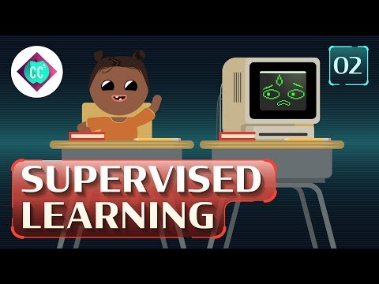
History of Neural Networks
Cue this and add URL

Slide 5
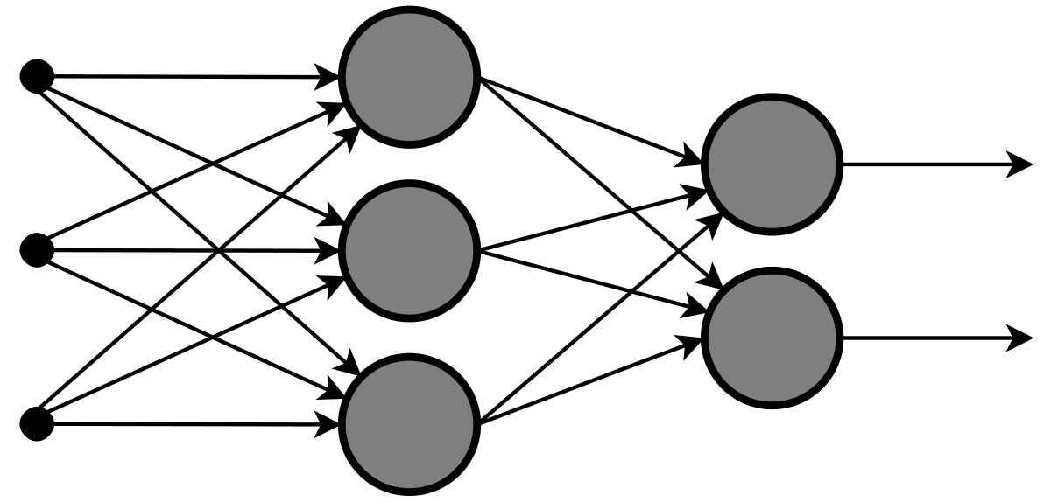
What is a neural network?
A large, complex mathematical function that maps inputs to outputs.
  Because the function is so complex, the network can do sophisticated things.
Each layer is composed of many simple functions, called “units” or “neurons”.
Each unit takes multiple numbers as input and produces a number as output.
units
a number
a number
a number
a number
a number
weighted connections

Slide 6
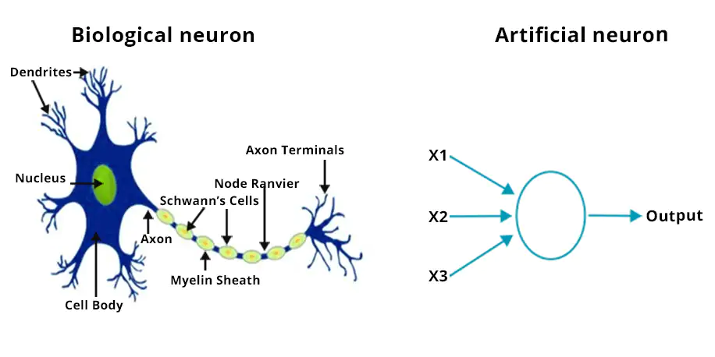
Why are they called “neural” networks?
The human brain contains roughly 86 billion neurons wired together in intricate patterns. This is the inspiration for artificial neural networks.
But biological neurons are more complex than artificial neurons, and real brain wiring is more complex than artificial neural networks.

Slide 7
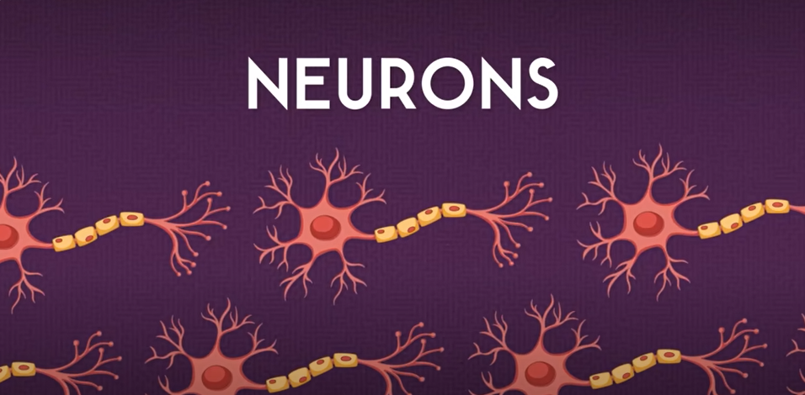
How do Neural Networks work?
[Video Option 1]
Cue this and add URL

Slide 8
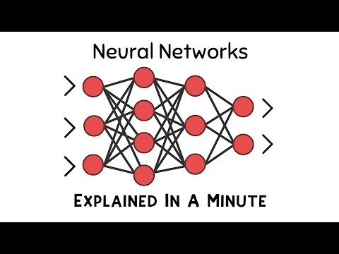
Neural Networks in a Minute
[Video Option 2]
URL (time)

Slide 9
Neural Networks Are Organized In Layers
Input
Layer
Hidden
Layer
Output
Layer

Slide 10

Deep Neural Networks Have Many Layers
Notes:
Teacher note - this can potentially get really complicated

Slide 11
Let’s focus on how one neuron learns

Slide 12
Learning to predict if you should pet an animal
Start with a bunch of “experts”. This is our input layer.
Some experts are good for predicting pettibility
But which are accurate?
Every expert starts out with 1 vote.
1 vote
1 vote
1 vote
1 vote
1 vote
1 vote
1 vote

Slide 13
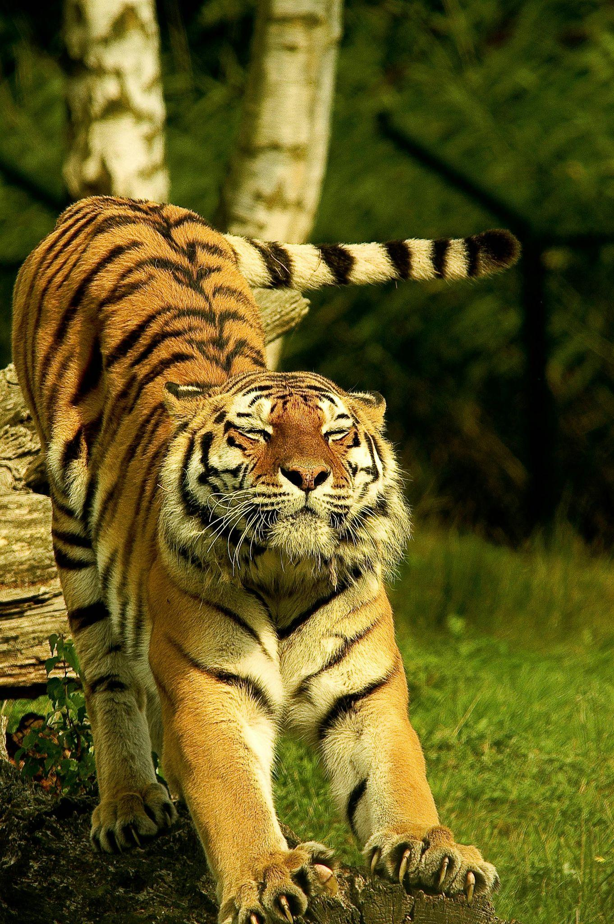
Should I pet this tiger? (1)
1 vote
NO
Tally
No Yes
4 votes 3 votes
1 vote
NO
1 vote
NO
1 vote
NO
1 vote
YES
1 vote
YES
1 vote
YES
Notes:
Possible Activity for more participatory
Students get a deck of cards with the dog pictures and what the experts will say
Then they get to update their number of votes on their sheet.
Class a a whole completes the tally.
Option1 - Classroom Context: Each person gets to have a card for an expert.
Need Prompting cards
This is what the cards will look like.
Option 2 - Game - Neural Networks invent their own experts..If you have enough experts…you can solve your problem.
Pick a domain where they don’t have personal expertise (intutions) and have to rely on what the experts are saying. But we don’t
Which of these bacteria causes spoiled milk?
Pictures of bacteria
There are some features that cause spoiled milk
You and your friends are building a detector that will do the right things
If your team is successful, you will be able to predict the label successfully …even though you can’t eyeball the input.
At the end we can reveal what the experts are paying attention to.
Level II - no expert that is al
Learning Objective
Using a procedure for

Slide 14


Should I pet this tiger? (1)
1.1 votes
NO
1.1 votes
NO
Give more votes to the experts who answered correctly. Subtract votes from the ones who got it wrong.
1.1 votes
NO
1.1 votes
NO
0.9 votes
YES
0.9 votes
YES
No!
0.9 votes
YES

Slide 15
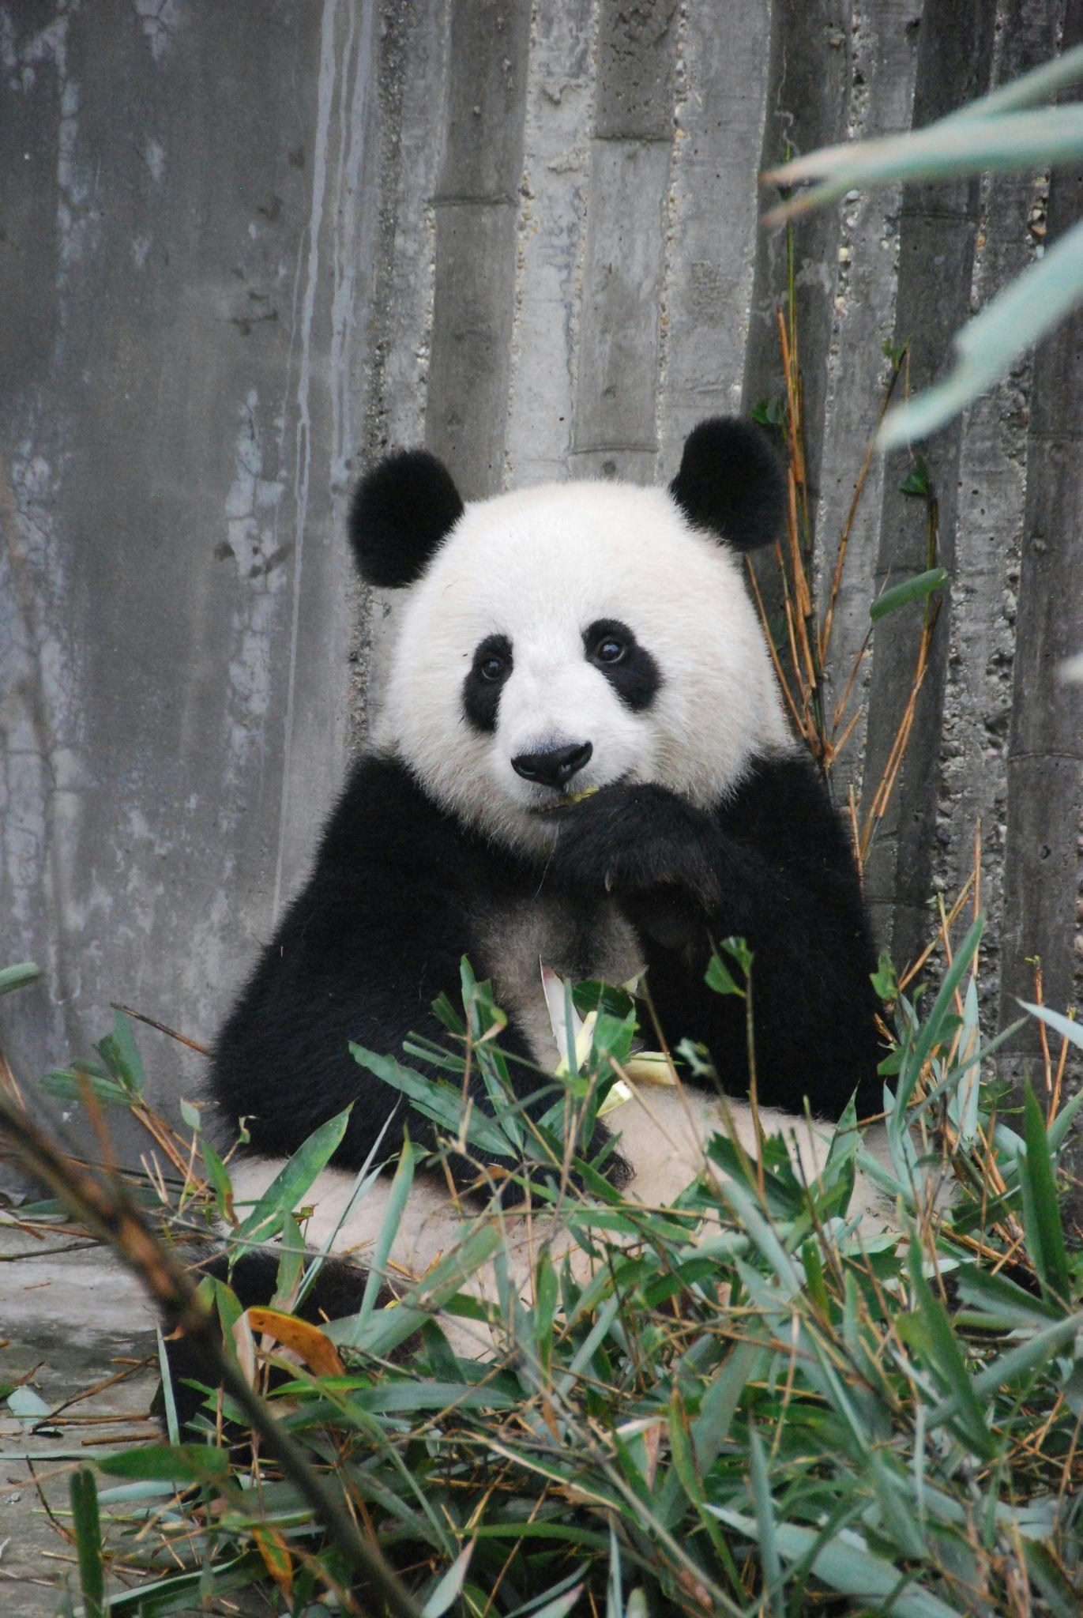
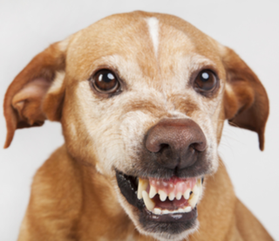
Should I pet this Panda Bear? (1)
1.1 votes
NO
Tally
No Yes
4.0 votes 3.1 votes
1.1 votes
NO
1.1 votes
YES
1.1 votes
YES
0.9 votes
YES
0.9 votes
NO
0.9 votes
NO

Slide 16
Should I pet this Panda Bear? (1)
1.0 votes
NO
1.0 votes
NO
Give more votes to the experts who answered correctly. Subtract votes from the ones who got it wrong.
1.2 votes
YES
1.2 votes
YES
1.0 votes
YES
0.8 votes
NO
No!
0.8 votes
NO

Slide 17

Should I pet this cool Raccoon? (1)
1.0 votes
NO
Tally
No Yes
5.2 votes 1.8 votes
1.0 votes
YES
1.2 votes
NO
1.2 votes
NO
1.0 votes
NO
0.8 votes
YES
0.8 votes
NO

Slide 18
Should I pet this cool Raccoon? (1)
1.1 votes
NO
0.9 votes
YES
Give more votes to the experts who answered correctly. Subtract votes from the ones who got it wrong.
1.3 votes
NO
1.3 votes
NO
1.1 votes
NO
0.7 votes
YES
No!
0.9 votes
NO

Slide 19
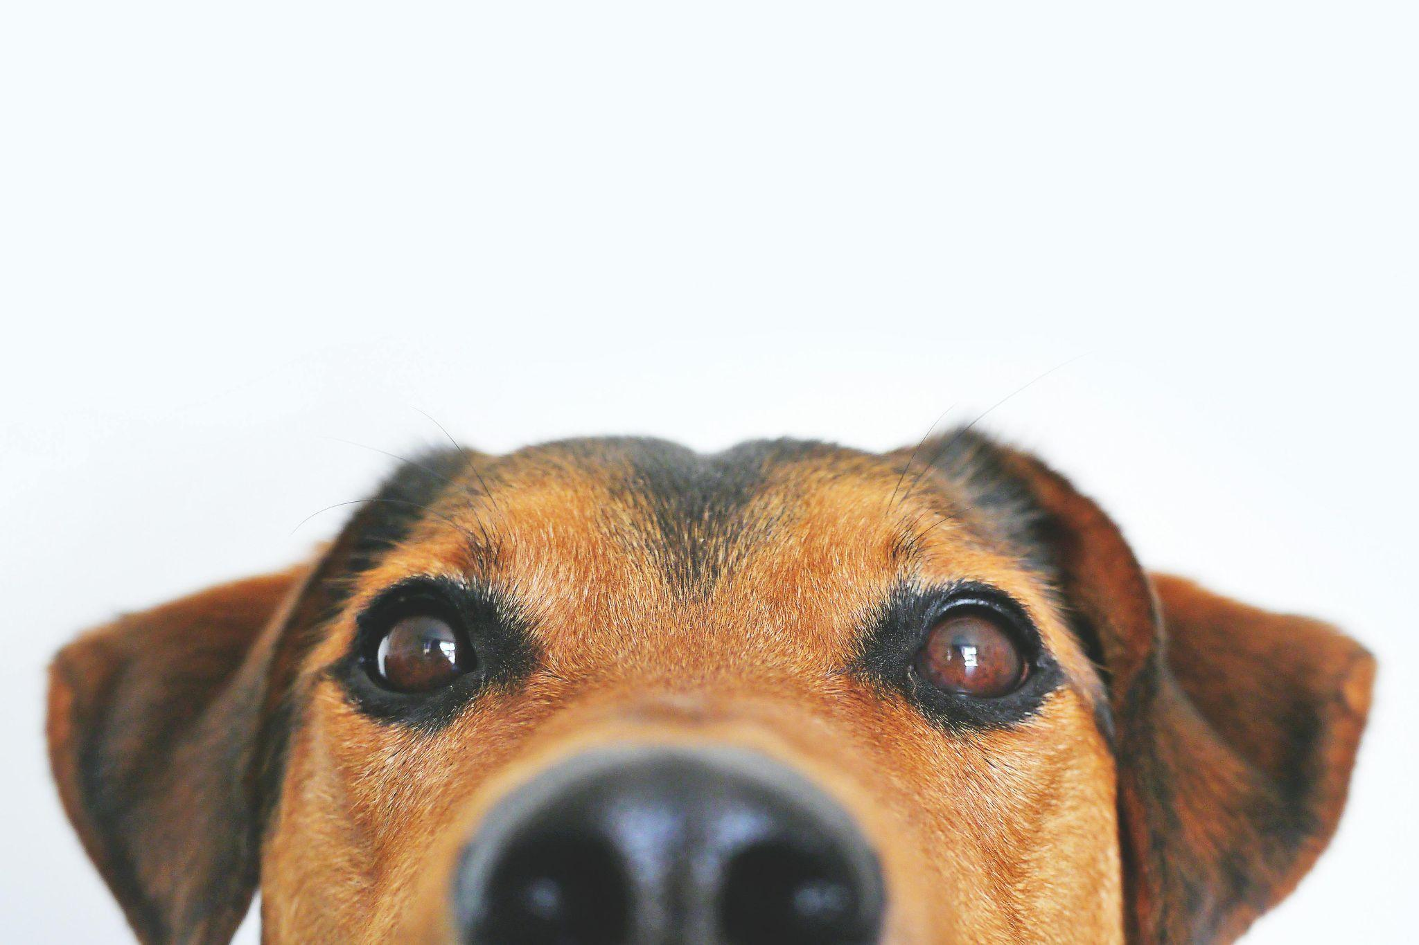
Should I pet this dog? (1)
1.1 votes
YES
Tally
No Yes
2.5 votes 4.8 votes
0.9 votes
NO
1.3 votes
YES
1.3 votes
YES
1.1 votes
YES
0.7 votes
NO
0.9 votes
NO

Slide 20
Should I pet this dog? (1)
1.2 votes
YES
0.8 votes
NO
Give more votes to the experts who answered correctly. Subtract votes from the ones who got it wrong.
1.4 votes
YES
1.4 votes
YES
1.2 votes
YES
Yes!
0.6 votes
NO
0.8 votes
NO

Slide 21
Turning our pettable animal predictor into a neural network
Weight = w_{i} (the number of votes that expert gets)
Inputs = x_{i}
1.2
The experts supply inputs
x_{i} = +1
for “yes” or -1 for “no”
0.8
“neuron”
1.4
Σ^{>0}
1.4
1.2
0.6
0.8
“Activation” a = Σ w_{i}x_{i}
a > 0 means “animal is pettable”
Notes:
Neural Nets are like a function
X input -> Y output
Were inputs can map to a number of Y’s

Slide 22
Let’s look at
how the neuron computes its answer
Notes:
Note add a neuron with a magnifying glass

Slide 23
The simplest possible unit: the linear unit
Each input x_{i} is multiplied by the corresponding weight w_{i}. Sum ∑ the results.
Inputs
Weights
Summation
Output
x₁
w₁
∑
y
x₂
w₂
x₁ × w₁ + x₂ × w₂ = y
Notes:
Link to Dave’s teaching videos
Teacher note - as a class do slides 30-37
Student activity starts on 38

Slide 24

The linear threshold unit produces
a binary output
Remember the Perceptron….
x₁
w₁
∑>0
0 for “no” or 1 for “yes”
x₂
w₂
a = x₁ × w₁ + x₂ × w₂ activation - equation or formula
y =
1 if a > 0
Binary outputs - 0 or 1
0 if a ≤ 0

Slide 25
Lesson Extras - Teacher Takeaways

Slide 26
Learning Algorithms
Building neural nets by hand requires careful attention to the weights.
  Only feasible for small networks.
What we need is a learning algorithm that can set the weights for us.
All we have to do is show it some training data so it knows what output we want to produce for each input.
The “should I pet this animal” network was trained using a very simple learning algorithm...

Slide 27
Relationship between Big Ideas 2 and 3
The pettible animal predicting neural network is doing reasoning.
  It’s solving a classification problem.
The input representation used by the network is a feature vector.
  Each expert contributes one feature.
  The features could be binary (-1/+1) or real values from -1 to +1.
Another important representation is the weight vector.
The learning algorithm adjusts the weight vector so as to improve the performance of the reasoner. Once learning is complete, using the network to classify new dog images is reasoning (Module 3.1).

